Slide 1
ENSE 470, Milestone 6
ByteThis
Alwin Baby, Konstantin Kharitonov, Taylor Petrychyn
March 28, 2018

Slide 2
Executive summary
Technology used
  Database: PostgreSQL
  Language: Node.js (Backend), jQuery (Frontend)
  Style Framework: Bootstrap 4
User story map changes
  User management moved to future release
  Password recovery/reset backlogged

Slide 3
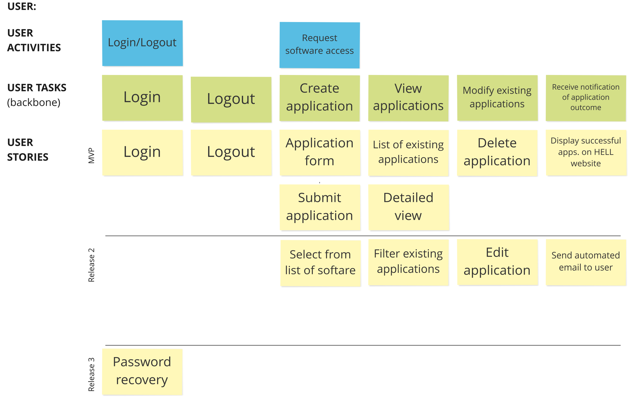
  Notes: Password recovery moved to backlog

Slide 4
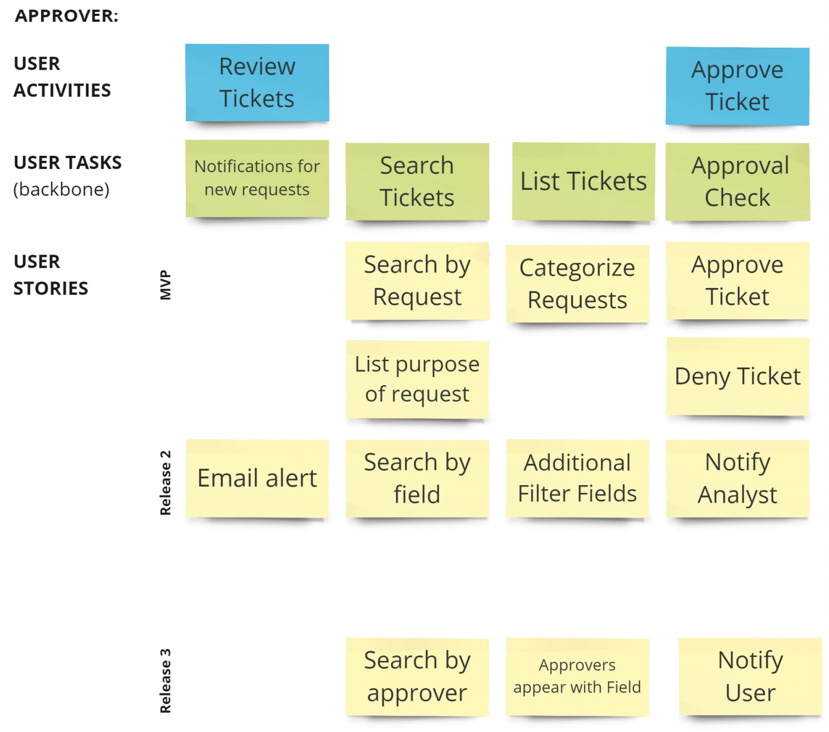

Slide 5
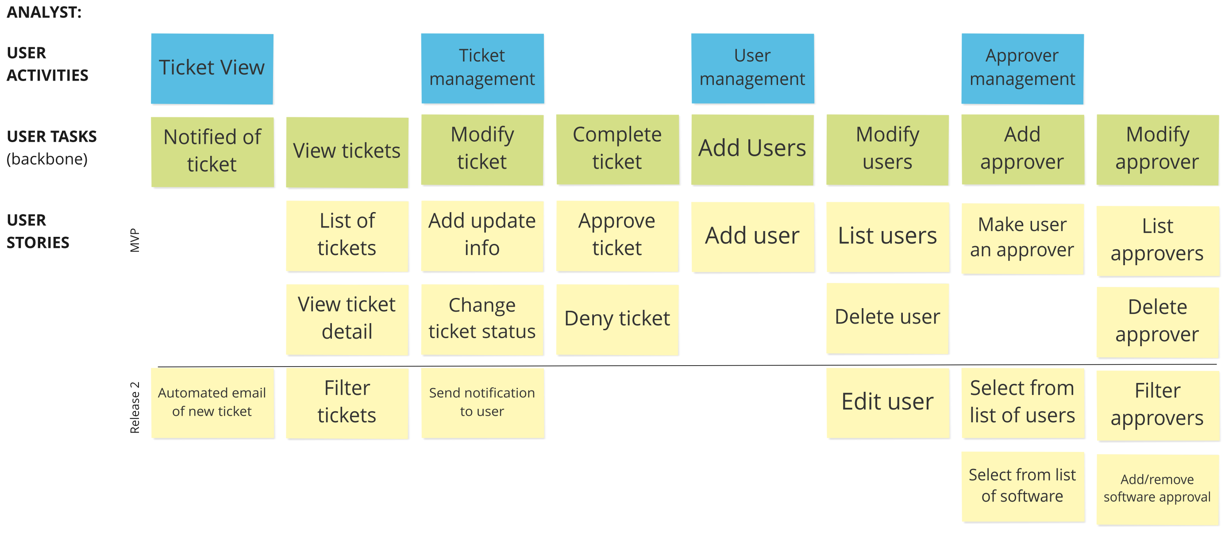
  Notes: User management moved to future release

Slide 6
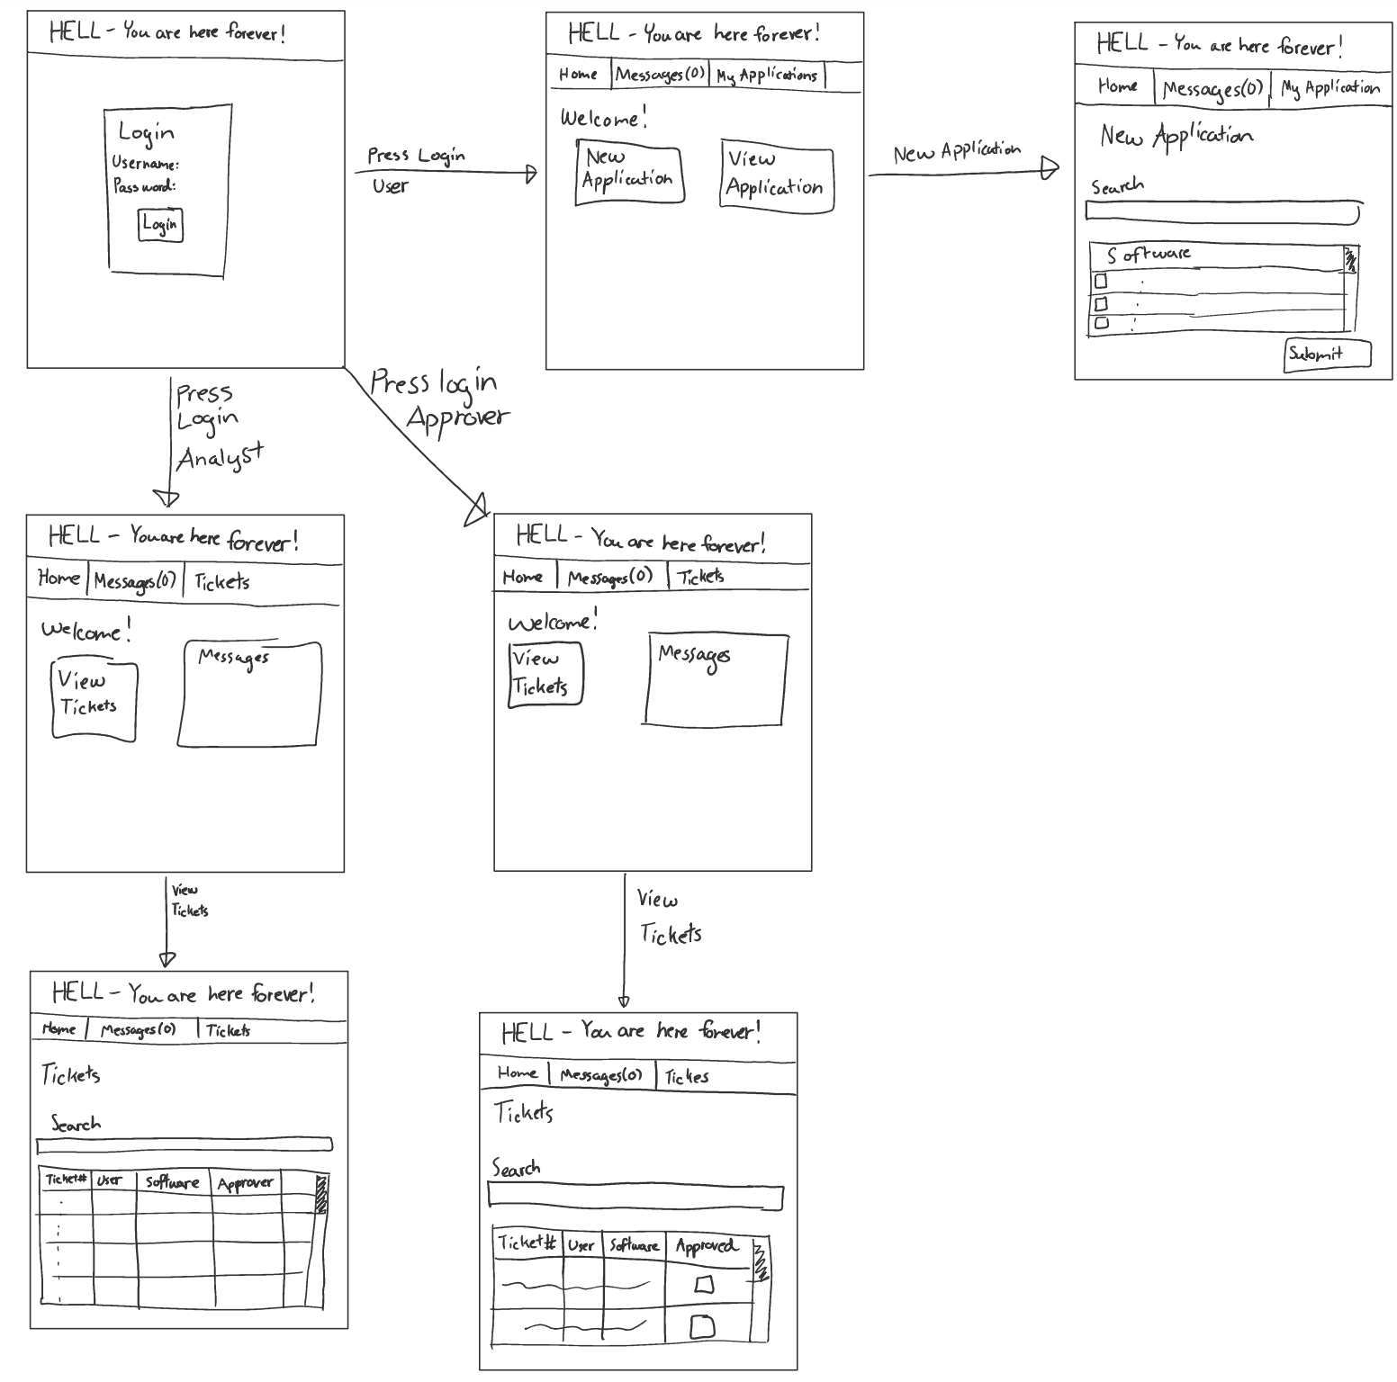

Slide 7
Demo
Demo your group’s working tool
  Compare with your group’s lo-fi prototype
Highlight MVP for release 1 (what was “done”)
Illustrate some of the Acceptance Test-Driven Development test validations
Design patterns used?
  Model-View-Controller
    View (HTML/CSS pages), Controller (Javascript modules for each separate page), Model (Node REST API)
  Observer
    Email notification

Slide 8
Group reflection
How did you feel about this milestone? What did you like about it? What did you dislike?
  Felt like a lot more work than previous milestones
What did you learn about yourself as you collaborated and worked through this milestone?
  [Response here]
How will you use what you have learned going forward?
  Can apply knowledge to Software jobs
What “stuff & things” related to this milestone would you want help with?
  [Response here]

